Slide 1
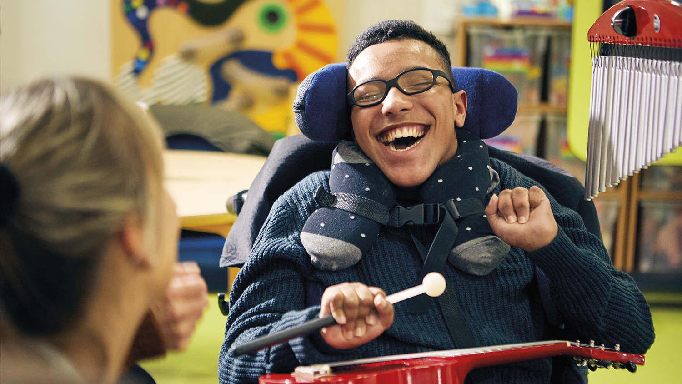
Demelza & ABG
March 2026

Slide 2
Key facts
Extraordinary care for extraordinary children
Over 2,500 children and their family members each year
East Sussex, Kent and South East London
Helping celebrating the joy in family life and making precious memories during challenging times
Support unique to every child and family
Specialist nursing and care team
24/7, 365, free of charge to families
^{83p}
166
83p of every £1 goes directly into our Care services
New families referred to us
(f/y 2024-2025)
2,500
Children and family members we are currently supporting
Notes:
This is a recap slide and here in case the video doesn’t work! (You don’t need to go through it all, just use elements you want to stress)
For those of you who don’t know:
We were founded over 25 years ago and are named after Demelza Phillips, who inspired the creation of our first hospice and our charity.
Demelza delivers extraordinary care to extraordinary children who are facing serious or life-limiting conditions
We do this throughout Kent, South East London and East Sussex and are here to support them and their families at every step – from first diagnosis and for as long as we’re needed. We support children and families where we’re needed most: in our hospices, in their homes, in local communities and online.
We’re currently supporting over 2,500 children and their family members, across a hugely diverse patch of the country:
Diverse in ethnicities as well as socio-economic factors.
babies, children and young people
serious or life-limiting conditions
Conditions range from things you will have heard of like: epilepsy, childhood cancers, brain tumours, neurological conditions, and include genetic conditions so rare they don't have a name, just a series of numbers.
So the children we support are hugely diverse in their needs and our team are specialist paediatric nurses and HCA’s.
We go beyond providing outstanding clinical care and emotional support.
Offer support unique to every child and family
Helping to celebrate the joy in family life and making precious memories during challenging times.
24 / 7 / 365, free to families
You’re in good company – in supporting us you’re joining organisations like (list partners that may interest them / are in their sphere):
Who support us on a team and corporate level
NB – you can change this to your relevant partners and supporters, and you’ll need to check this is up to date before you present so as not to mislead people!

Slide 3
Demelza in East Kent
¹⁷¹
⁴⁸⁷
252
Children and family members supported through events such as spring get togethers
Children and family members supported
⁵⁰
Bereaved family members supported
Art or Music therapy sessions provided
Notes:
This is a recap slide and here in case the video doesn’t work! (You don’t need to go through it all, just use elements you want to stress)
For those of you who don’t know:
We were founded over 25 years ago and are named after Demelza Phillips, who inspired the creation of our first hospice and our charity.
Demelza delivers extraordinary care to extraordinary children who are facing serious or life-limiting conditions
We do this throughout Kent, South East London and East Sussex and are here to support them and their families at every step – from first diagnosis and for as long as we’re needed. We support children and families where we’re needed most: in our hospices, in their homes, in local communities and online.
We’re currently supporting over 2,500 children and their family members, across a hugely diverse patch of the country:
Diverse in ethnicities as well as socio-economic factors.
babies, children and young people
serious or life-limiting conditions
Conditions range from things you will have heard of like: epilepsy, childhood cancers, brain tumours, neurological conditions, and include genetic conditions so rare they don't have a name, just a series of numbers.
So the children we support are hugely diverse in their needs and our team are specialist paediatric nurses and HCA’s.
We go beyond providing outstanding clinical care and emotional support.
Offer support unique to every child and family
Helping to celebrate the joy in family life and making precious memories during challenging times.
24 / 7 / 365, free to families
You’re in good company – in supporting us you’re joining organisations like (list partners that may interest them / are in their sphere):
Who support us on a team and corporate level
NB – you can change this to your relevant partners and supporters, and you’ll need to check this is up to date before you present so as not to mislead people!

Slide 4
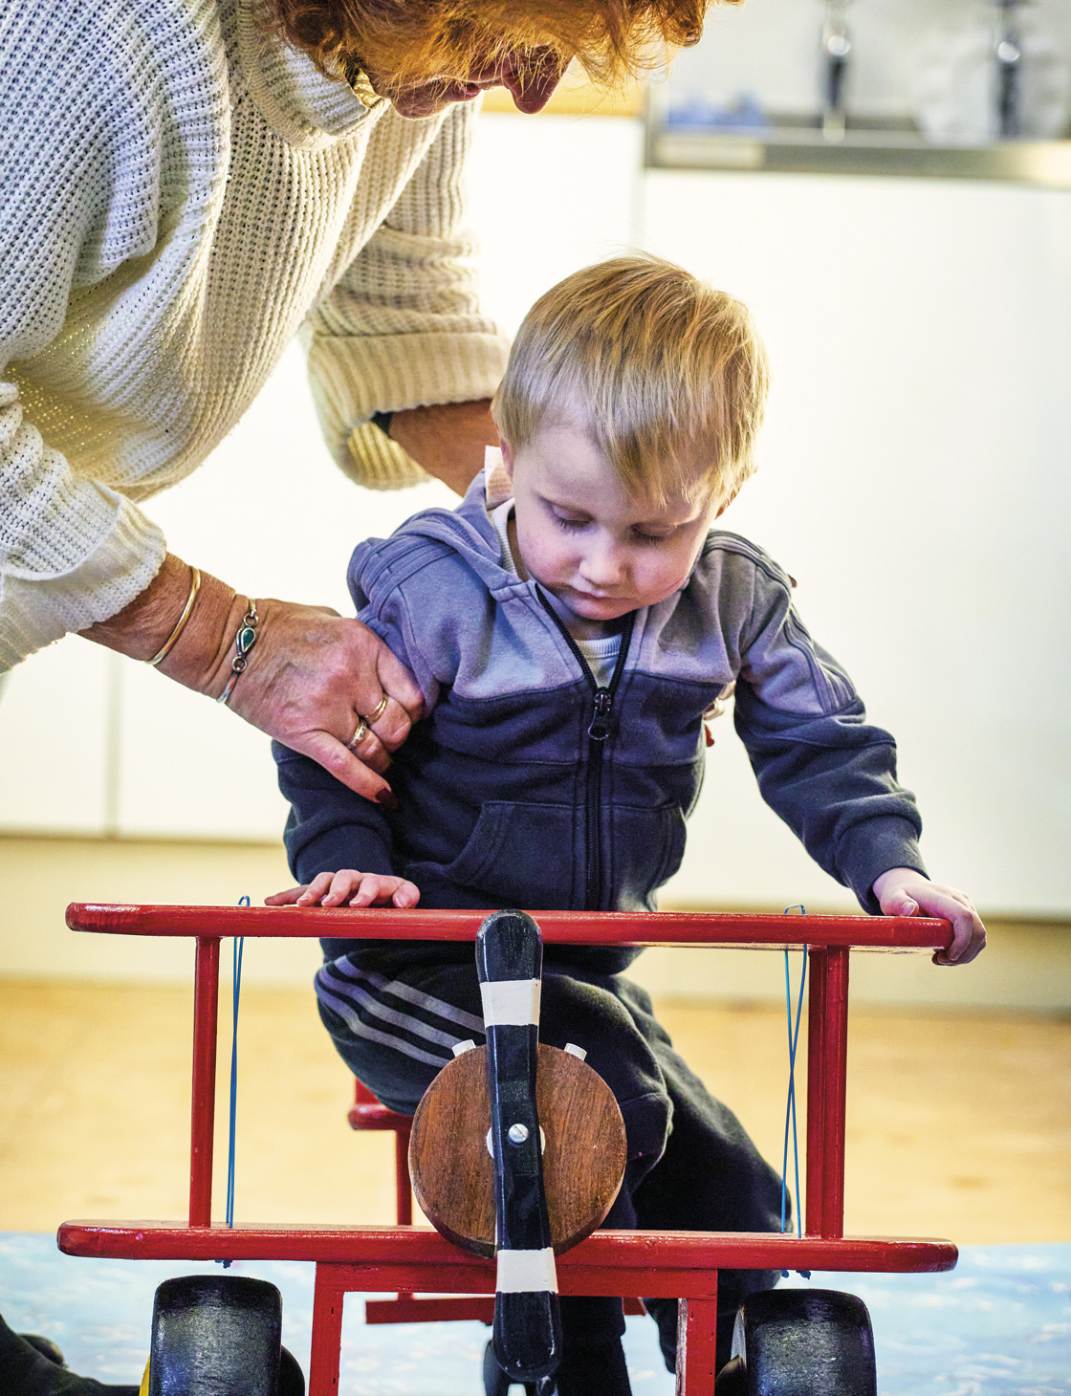
How does Demelza support?
Notes:
Who’s who: Sharon (grandma) and Albie (child)
We’re here to support family life. We want life to be the best it can be for children who have serious or life-limiting conditions – and for their families, and all those who love them.
Our specialist clinical nursing and community care teams provide advice that enables parents to meet their children’s complex medical and social requirements with confidence.
We also help children to leave hospital, so they can be where they want to be – with their family.
We support the NHS and other medical services, as well as working in partnership with other healthcare charities (like Chestnut Tree House and Holding On, Letting Go) - if relevant to them
Our support services are unique as every child and family, and personalised to adapt around their specific circumstances: from creative therapies and short breaks, to practical and emotional support for families and siblings, alongside expert clinical and end of life care.
Our specialist teams are on hand day and night, all year round, including:
Day care in our hospices, the community and in family homes
Short breaks (respite)
Family and sibling support
Creative therapies
Practical support
Memory making
End of life care and bereavement services
YOU DON’T NEED TO LIST ALL THE SERVICES, FOCUS ON JUST A FEW BY SAYING SOMETHING LIKE : Rather than run you through the full list of our services, I wanted to share some family stories with you that show the impact of them and our support…

Slide 5
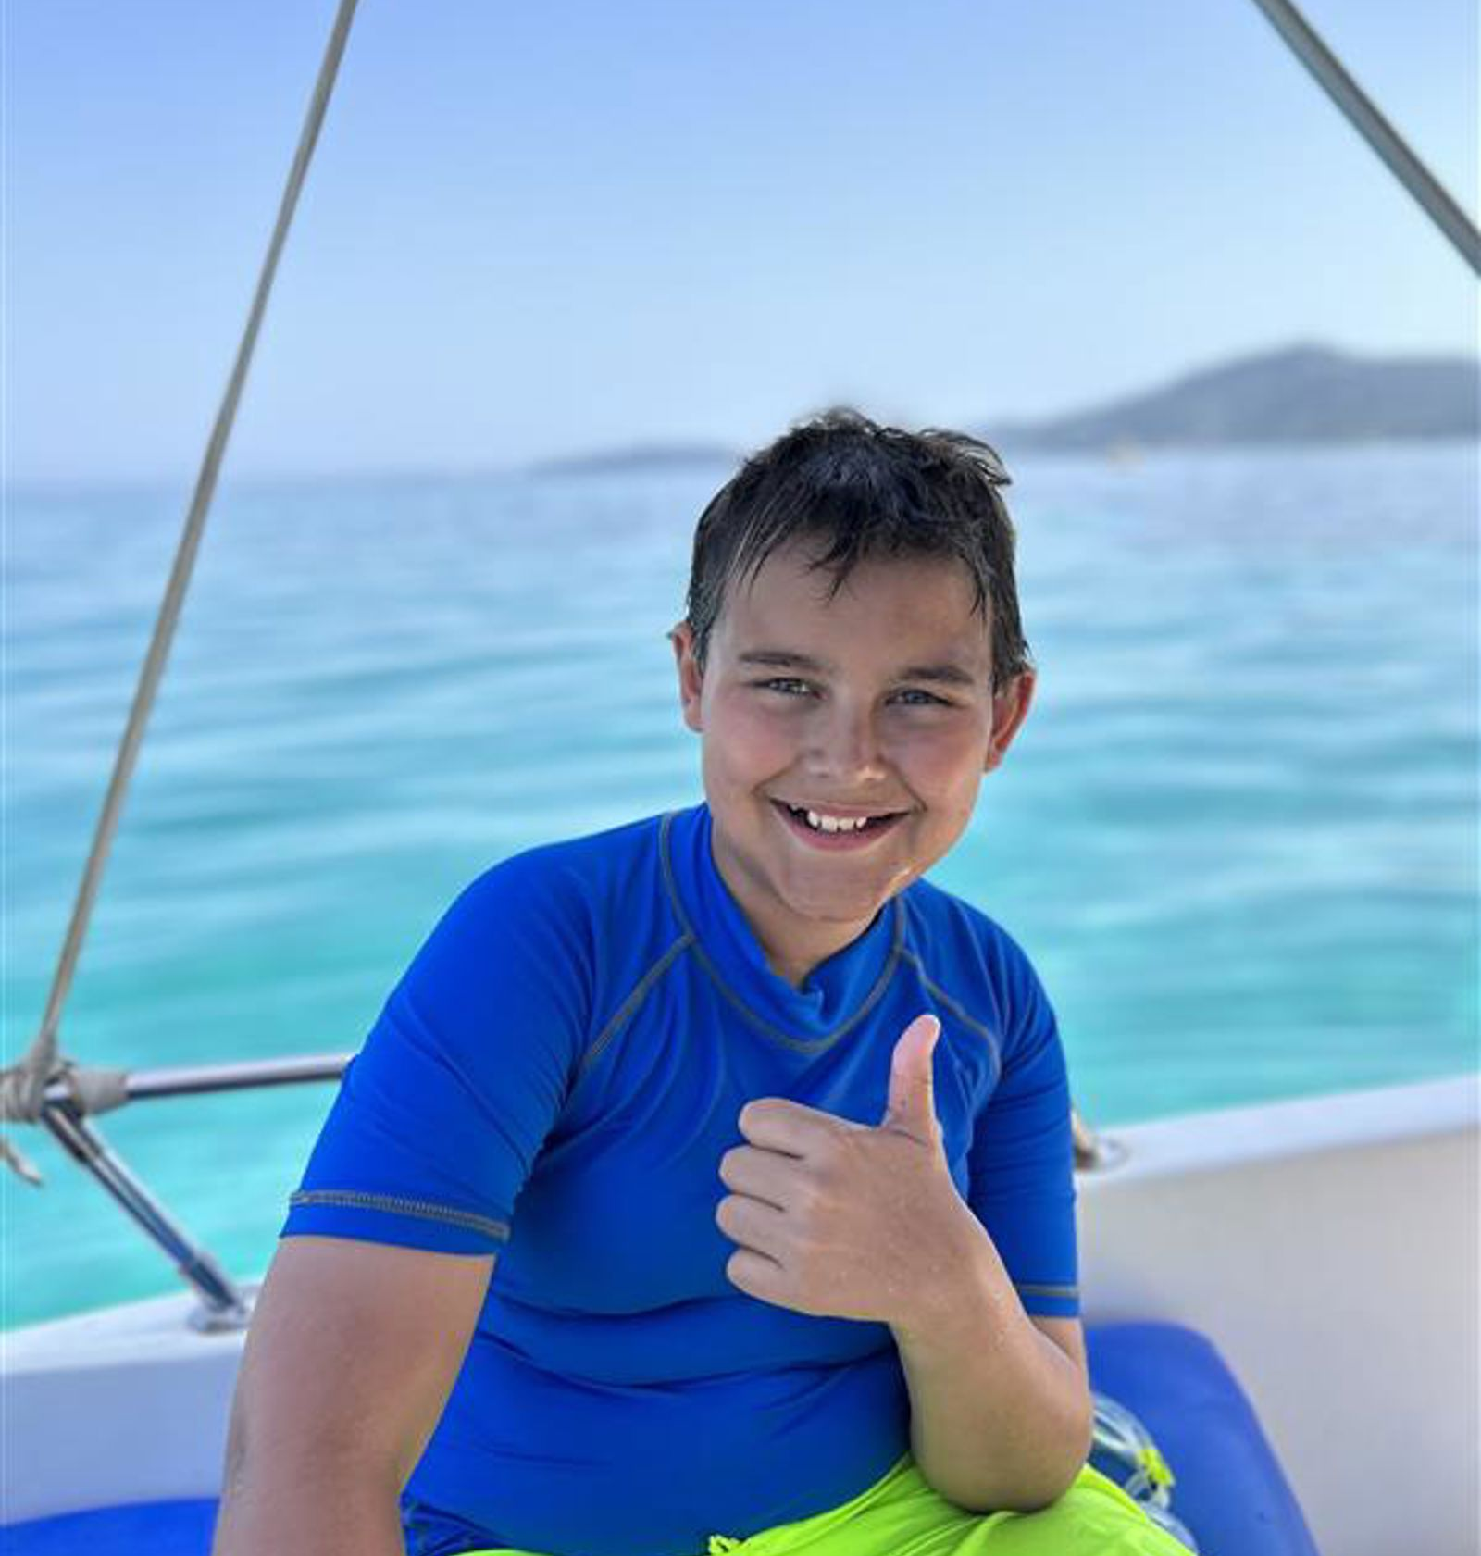
Josh's Story
Joshua was diagnosed with a rare form of cancer and sadly died just four days before his 13th birthday.
Demelza’s bereavement suite gave Joshua’s parents, Donna and Duncan, the chance to be with him on this birthday and say goodbye in their own time.
“It’s a place no child should need, but we are incredibly grateful that it was there for us at the worst time of our lives.”
Video: https://www.youtube.com/watch?v=E-JeEGitO9g
Notes:
End of life, bereavement support, art therapy - Henry’s story
Our community and nursing teams has provided exceptional end of life care in the child or young person’s home, and supporting the spiritual, cultural and emotional needs of the whole family.
Some families will choose to go to a hospital, but more now are choosing to be at home, with their bed and comforts, family and familiarities.
During the COVID pandemic, we saw a rise in oncology referrals to our service for symptom management and end of life care, due to the broader pandemic implications of reducing travel and contact, not the virus itself
Since then, the referrals have sadly continued to rise
WHO
Henry and his brother Edward (pictured left and right). His parents, Sam and Hua, allowed us to share his story with you.
Henry was a leader.
He was always at the forefront, first in at everything; he never missed an opportunity.
He took his little brother Edward under his wing instantly.
PROBLEM
Henry was only six when he was diagnosed with acute myeloid leukaemia (AML)
Despite receiving aggressive treatment and going into remission, he relapsed multiple times prior to Covid
During that time he spent months in hospital, during Covid 19
This meant the family had limited opportunities to be together and to make memories together
ACTION
After several bouts of treatment, Henry and his family were referred to Demelza’s SEL team.
The team helped them make lasting and precious memories with Henry - when he was out of hospital, a trip to the Danson Fireworks Show in November 2021; plaster casts of his hands; jewellery with his fingerprints on.
RESULT
In February 2022, his health rapidly deteriorated; he developed sepsis during a stay in hospital and ended up in the intensive care ward at St George’s (SE London).
Sadly, he didn’t respond to treatment and after only a few days the family found themselves saying goodbye to their little boy.
Henry was transferred to Demelza’s hospice in Eltham, South East London, after he died.
His Mum Sam said: ‘It was so important to us at that time that he didn’t have to go anywhere else first”, he went straight to Demelza from the hospital.
He stayed in his own special bedroom, where his favourite music played quietly in the background, and they had the time and space to begin to come to terms with their loss. This wouldn’t have been possible had he died in hospital.
Demelza staff were there for Sam, Hua and their family in those first difficult days; giving them the opportunity to talk, as well as guiding them through the practical arrangements when they had no idea where to start.
Despite everything they were going through, “we felt an overwhelming sense of calm at Demelza”.
Henry’s brother Edward was supported by our team too and accessed art and music therapy over the five days after Henry had died. (Reference syringe art canvas example if you have it with you)
The care hasn’t stopped just because we left Demelza – he has continued his art therapy sessions, helping him process his loss in the setting that’s best for him.
And, we’re here for the family as long as they need us
“We never imagined that our first visit to Demelza would be after Henry died; but what we gained …where we stayed and came to terms with our loss while Henry lay peacefully in their bereavement suite, is immeasurable.”

Slide 6
Activity-
Quiz!!
Notes:
Who’s who: Sharon (grandma) and Albie (child)
We’re here to support family life. We want life to be the best it can be for children who have serious or life-limiting conditions – and for their families, and all those who love them.
Our specialist clinical nursing and community care teams provide advice that enables parents to meet their children’s complex medical and social requirements with confidence.
We also help children to leave hospital, so they can be where they want to be – with their family.
We support the NHS and other medical services, as well as working in partnership with other healthcare charities (like Chestnut Tree House and Holding On, Letting Go) - if relevant to them
Our support services are unique as every child and family, and personalised to adapt around their specific circumstances: from creative therapies and short breaks, to practical and emotional support for families and siblings, alongside expert clinical and end of life care.
Our specialist teams are on hand day and night, all year round, including:
Day care in our hospices, the community and in family homes
Short breaks (respite)
Family and sibling support
Creative therapies
Practical support
Memory making
End of life care and bereavement services
YOU DON’T NEED TO LIST ALL THE SERVICES, FOCUS ON JUST A FEW BY SAYING SOMETHING LIKE : Rather than run you through the full list of our services, I wanted to share some family stories with you that show the impact of them and our support…

Slide 7
How much does Demelza need to raise every year to continue supporting children & families?
11 million
19 million
Notes:
NEEDS A BETTER PAYROLL GIVING IMAGE WHEN IG GET THEIR PACK SORTED
Volunteering – if you have some spare time to volunteer, we are always needing volunteers in our shops, warehouse, gardens, events
Want something for you? Play our lottery from as little as £1 a week with prizes from £5 to £25,000!
Payroll Giving – you can opt in to regular donations from your payroll
Have a spring clean and donate your unwanted good quality items to our 29 retail shops
Come and find me afterwards to register your interest in anything – I promise not to hold you to it!
As a charity we rely almost entirely on the generosity of our supporters.
Every gesture, no matter how small, has a big impact on the lives of the children and families we support.
Maybe you’ll take on a fundraising challenge or join our lottery, maybe you’ll host a quiz, donate to our shops, or share our social posts.
The impact of corporate support like yours is so important to us and we’re looking forward to working together.
You can make a difference and give families support in their most difficult of times and help them make memories to last a lifetime.
Don’t think of it as fundraising, think of it as:
Giving a family like Kit’s their first referral call to begin accessing our services
Helping a struggling brother like Edward use art therapy to process his grief
Helping a family like Henry’s to get through their darkest times
Giving a parent like Nick a good night’s sleep
Giving specialist care to children like Kit where you and your customers and patients live and work
(use names from the case studies to remind them who they’ve seen, and use as many of the above as you see fit)

Slide 8
Correct!
Due to inflation, cost of living and increase of service users, Demelza now must raise £19 million to support children and families across Kent, South East London & East Sussex
Notes:
NEEDS A BETTER PAYROLL GIVING IMAGE WHEN IG GET THEIR PACK SORTED
Volunteering – if you have some spare time to volunteer, we are always needing volunteers in our shops, warehouse, gardens, events
Want something for you? Play our lottery from as little as £1 a week with prizes from £5 to £25,000!
Payroll Giving – you can opt in to regular donations from your payroll
Have a spring clean and donate your unwanted good quality items to our 29 retail shops
Come and find me afterwards to register your interest in anything – I promise not to hold you to it!
As a charity we rely almost entirely on the generosity of our supporters.
Every gesture, no matter how small, has a big impact on the lives of the children and families we support.
Maybe you’ll take on a fundraising challenge or join our lottery, maybe you’ll host a quiz, donate to our shops, or share our social posts.
The impact of corporate support like yours is so important to us and we’re looking forward to working together.
You can make a difference and give families support in their most difficult of times and help them make memories to last a lifetime.
Don’t think of it as fundraising, think of it as:
Giving a family like Kit’s their first referral call to begin accessing our services
Helping a struggling brother like Edward use art therapy to process his grief
Helping a family like Henry’s to get through their darkest times
Giving a parent like Nick a good night’s sleep
Giving specialist care to children like Kit where you and your customers and patients live and work
(use names from the case studies to remind them who they’ve seen, and use as many of the above as you see fit)

Slide 9
Incorrect
Due to inflation, cost of living and increase of service users, Demelza now must raise £19 million to support children and families across Kent, South East London & East Sussex
Notes:
NEEDS A BETTER PAYROLL GIVING IMAGE WHEN IG GET THEIR PACK SORTED
Volunteering – if you have some spare time to volunteer, we are always needing volunteers in our shops, warehouse, gardens, events
Want something for you? Play our lottery from as little as £1 a week with prizes from £5 to £25,000!
Payroll Giving – you can opt in to regular donations from your payroll
Have a spring clean and donate your unwanted good quality items to our 29 retail shops
Come and find me afterwards to register your interest in anything – I promise not to hold you to it!
As a charity we rely almost entirely on the generosity of our supporters.
Every gesture, no matter how small, has a big impact on the lives of the children and families we support.
Maybe you’ll take on a fundraising challenge or join our lottery, maybe you’ll host a quiz, donate to our shops, or share our social posts.
The impact of corporate support like yours is so important to us and we’re looking forward to working together.
You can make a difference and give families support in their most difficult of times and help them make memories to last a lifetime.
Don’t think of it as fundraising, think of it as:
Giving a family like Kit’s their first referral call to begin accessing our services
Helping a struggling brother like Edward use art therapy to process his grief
Helping a family like Henry’s to get through their darkest times
Giving a parent like Nick a good night’s sleep
Giving specialist care to children like Kit where you and your customers and patients live and work
(use names from the case studies to remind them who they’ve seen, and use as many of the above as you see fit)

Slide 10
How many charity shops does Demelza have?
12
29
Notes:
NEEDS A BETTER PAYROLL GIVING IMAGE WHEN IG GET THEIR PACK SORTED
Volunteering – if you have some spare time to volunteer, we are always needing volunteers in our shops, warehouse, gardens, events
Want something for you? Play our lottery from as little as £1 a week with prizes from £5 to £25,000!
Payroll Giving – you can opt in to regular donations from your payroll
Have a spring clean and donate your unwanted good quality items to our 29 retail shops
Come and find me afterwards to register your interest in anything – I promise not to hold you to it!
As a charity we rely almost entirely on the generosity of our supporters.
Every gesture, no matter how small, has a big impact on the lives of the children and families we support.
Maybe you’ll take on a fundraising challenge or join our lottery, maybe you’ll host a quiz, donate to our shops, or share our social posts.
The impact of corporate support like yours is so important to us and we’re looking forward to working together.
You can make a difference and give families support in their most difficult of times and help them make memories to last a lifetime.
Don’t think of it as fundraising, think of it as:
Giving a family like Kit’s their first referral call to begin accessing our services
Helping a struggling brother like Edward use art therapy to process his grief
Helping a family like Henry’s to get through their darkest times
Giving a parent like Nick a good night’s sleep
Giving specialist care to children like Kit where you and your customers and patients live and work
(use names from the case studies to remind them who they’ve seen, and use as many of the above as you see fit)

Slide 11
Incorrect
Demelza have 29 retail shops, bringing in around £4 million a year to support the hospice.
Notes:
NEEDS A BETTER PAYROLL GIVING IMAGE WHEN IG GET THEIR PACK SORTED
Volunteering – if you have some spare time to volunteer, we are always needing volunteers in our shops, warehouse, gardens, events
Want something for you? Play our lottery from as little as £1 a week with prizes from £5 to £25,000!
Payroll Giving – you can opt in to regular donations from your payroll
Have a spring clean and donate your unwanted good quality items to our 29 retail shops
Come and find me afterwards to register your interest in anything – I promise not to hold you to it!
As a charity we rely almost entirely on the generosity of our supporters.
Every gesture, no matter how small, has a big impact on the lives of the children and families we support.
Maybe you’ll take on a fundraising challenge or join our lottery, maybe you’ll host a quiz, donate to our shops, or share our social posts.
The impact of corporate support like yours is so important to us and we’re looking forward to working together.
You can make a difference and give families support in their most difficult of times and help them make memories to last a lifetime.
Don’t think of it as fundraising, think of it as:
Giving a family like Kit’s their first referral call to begin accessing our services
Helping a struggling brother like Edward use art therapy to process his grief
Helping a family like Henry’s to get through their darkest times
Giving a parent like Nick a good night’s sleep
Giving specialist care to children like Kit where you and your customers and patients live and work
(use names from the case studies to remind them who they’ve seen, and use as many of the above as you see fit)

Slide 12
Correct!
Demelza has 16 shops in Kent alone... visit your local in Canterbury or Herne Bay for some great deals or to donate some of your old goods!
Notes:
NEEDS A BETTER PAYROLL GIVING IMAGE WHEN IG GET THEIR PACK SORTED
Volunteering – if you have some spare time to volunteer, we are always needing volunteers in our shops, warehouse, gardens, events
Want something for you? Play our lottery from as little as £1 a week with prizes from £5 to £25,000!
Payroll Giving – you can opt in to regular donations from your payroll
Have a spring clean and donate your unwanted good quality items to our 29 retail shops
Come and find me afterwards to register your interest in anything – I promise not to hold you to it!
As a charity we rely almost entirely on the generosity of our supporters.
Every gesture, no matter how small, has a big impact on the lives of the children and families we support.
Maybe you’ll take on a fundraising challenge or join our lottery, maybe you’ll host a quiz, donate to our shops, or share our social posts.
The impact of corporate support like yours is so important to us and we’re looking forward to working together.
You can make a difference and give families support in their most difficult of times and help them make memories to last a lifetime.
Don’t think of it as fundraising, think of it as:
Giving a family like Kit’s their first referral call to begin accessing our services
Helping a struggling brother like Edward use art therapy to process his grief
Helping a family like Henry’s to get through their darkest times
Giving a parent like Nick a good night’s sleep
Giving specialist care to children like Kit where you and your customers and patients live and work
(use names from the case studies to remind them who they’ve seen, and use as many of the above as you see fit)

Slide 13
How much government support do we receive per year (children's hospice grant)
Roughly £1.5 million
Roughly £5.5 million
Notes:
NEEDS A BETTER PAYROLL GIVING IMAGE WHEN IG GET THEIR PACK SORTED
Volunteering – if you have some spare time to volunteer, we are always needing volunteers in our shops, warehouse, gardens, events
Want something for you? Play our lottery from as little as £1 a week with prizes from £5 to £25,000!
Payroll Giving – you can opt in to regular donations from your payroll
Have a spring clean and donate your unwanted good quality items to our 29 retail shops
Come and find me afterwards to register your interest in anything – I promise not to hold you to it!
As a charity we rely almost entirely on the generosity of our supporters.
Every gesture, no matter how small, has a big impact on the lives of the children and families we support.
Maybe you’ll take on a fundraising challenge or join our lottery, maybe you’ll host a quiz, donate to our shops, or share our social posts.
The impact of corporate support like yours is so important to us and we’re looking forward to working together.
You can make a difference and give families support in their most difficult of times and help them make memories to last a lifetime.
Don’t think of it as fundraising, think of it as:
Giving a family like Kit’s their first referral call to begin accessing our services
Helping a struggling brother like Edward use art therapy to process his grief
Helping a family like Henry’s to get through their darkest times
Giving a parent like Nick a good night’s sleep
Giving specialist care to children like Kit where you and your customers and patients live and work
(use names from the case studies to remind them who they’ve seen, and use as many of the above as you see fit)

Slide 14
Incorrect
It's actually £1.5 million...this is secured for the next 3 years, however we can only use on direct clinical care which is only a small part of the care Demelza provide.​
Notes:
NEEDS A BETTER PAYROLL GIVING IMAGE WHEN IG GET THEIR PACK SORTED
Volunteering – if you have some spare time to volunteer, we are always needing volunteers in our shops, warehouse, gardens, events
Want something for you? Play our lottery from as little as £1 a week with prizes from £5 to £25,000!
Payroll Giving – you can opt in to regular donations from your payroll
Have a spring clean and donate your unwanted good quality items to our 29 retail shops
Come and find me afterwards to register your interest in anything – I promise not to hold you to it!
As a charity we rely almost entirely on the generosity of our supporters.
Every gesture, no matter how small, has a big impact on the lives of the children and families we support.
Maybe you’ll take on a fundraising challenge or join our lottery, maybe you’ll host a quiz, donate to our shops, or share our social posts.
The impact of corporate support like yours is so important to us and we’re looking forward to working together.
You can make a difference and give families support in their most difficult of times and help them make memories to last a lifetime.
Don’t think of it as fundraising, think of it as:
Giving a family like Kit’s their first referral call to begin accessing our services
Helping a struggling brother like Edward use art therapy to process his grief
Helping a family like Henry’s to get through their darkest times
Giving a parent like Nick a good night’s sleep
Giving specialist care to children like Kit where you and your customers and patients live and work
(use names from the case studies to remind them who they’ve seen, and use as many of the above as you see fit)

Slide 15
Correct!
This is secured for the next 3 years, however we can only use on direct clinical care which is only a small part of the care Demelza provide.
Notes:
NEEDS A BETTER PAYROLL GIVING IMAGE WHEN IG GET THEIR PACK SORTED
Volunteering – if you have some spare time to volunteer, we are always needing volunteers in our shops, warehouse, gardens, events
Want something for you? Play our lottery from as little as £1 a week with prizes from £5 to £25,000!
Payroll Giving – you can opt in to regular donations from your payroll
Have a spring clean and donate your unwanted good quality items to our 29 retail shops
Come and find me afterwards to register your interest in anything – I promise not to hold you to it!
As a charity we rely almost entirely on the generosity of our supporters.
Every gesture, no matter how small, has a big impact on the lives of the children and families we support.
Maybe you’ll take on a fundraising challenge or join our lottery, maybe you’ll host a quiz, donate to our shops, or share our social posts.
The impact of corporate support like yours is so important to us and we’re looking forward to working together.
You can make a difference and give families support in their most difficult of times and help them make memories to last a lifetime.
Don’t think of it as fundraising, think of it as:
Giving a family like Kit’s their first referral call to begin accessing our services
Helping a struggling brother like Edward use art therapy to process his grief
Helping a family like Henry’s to get through their darkest times
Giving a parent like Nick a good night’s sleep
Giving specialist care to children like Kit where you and your customers and patients live and work
(use names from the case studies to remind them who they’ve seen, and use as many of the above as you see fit)

Slide 16
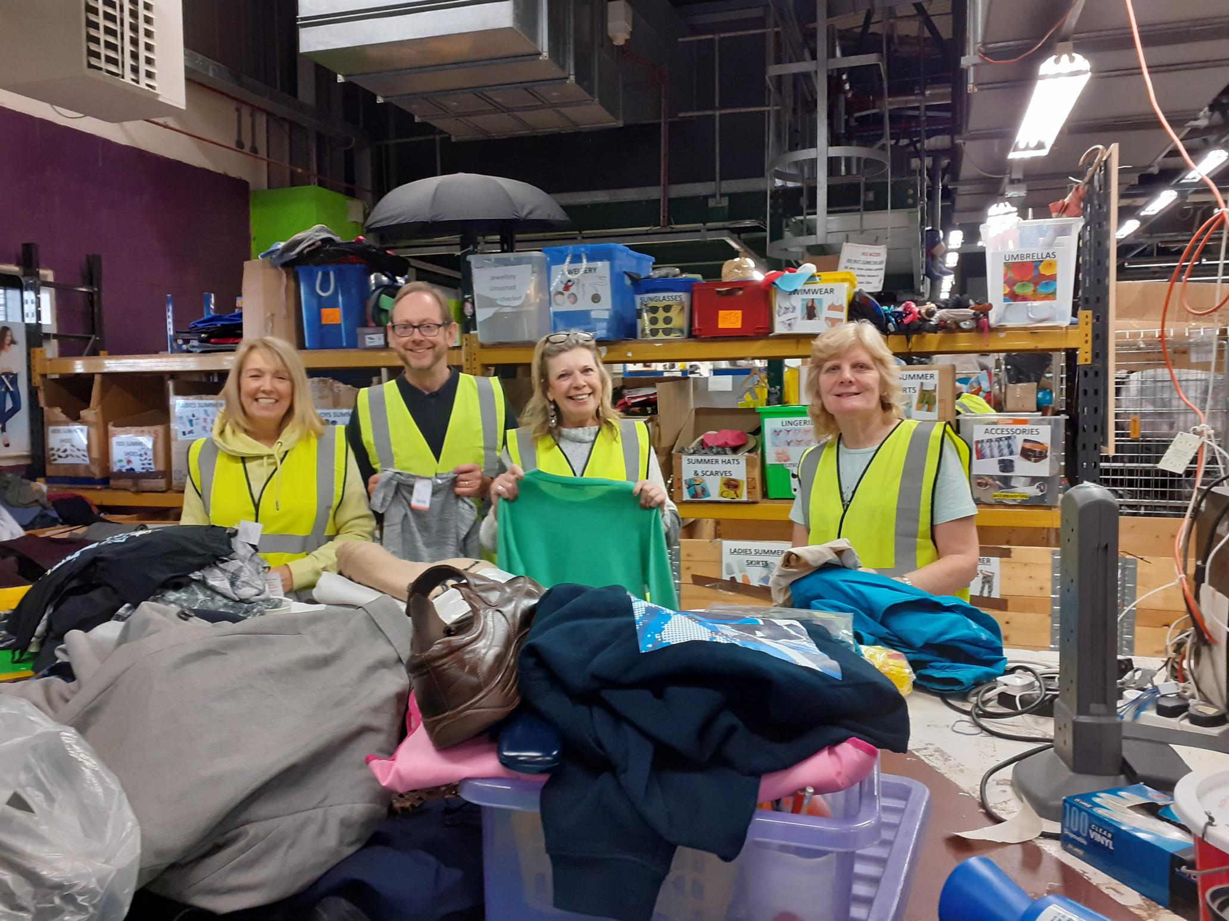



Get involved!
Volunteering
In our shops and retail warehouse
In our gardens
At events
In the community
Regular or ad hoc
Events
Organise a sponsored walk/challenge as a group & encourage colleagues outside of ABG.
OR
Take part in a Demelza event- skydive, bubble rush, Iceland trek!
Awareness
Help us spread awareness on socials by sharing campaigns and events.
Clear out for kids!
All year, 29 shops
Donate your preloved fashion, gifts or furniture
29 charity shops across the South East!
Gift Aid your donations to add 25% on their sale price
Notes:
NEEDS A BETTER PAYROLL GIVING IMAGE WHEN IG GET THEIR PACK SORTED
Volunteering – if you have some spare time to volunteer, we are always needing volunteers in our shops, warehouse, gardens, events
Want something for you? Play our lottery from as little as £1 a week with prizes from £5 to £25,000!
Payroll Giving – you can opt in to regular donations from your payroll
Have a spring clean and donate your unwanted good quality items to our 29 retail shops
Come and find me afterwards to register your interest in anything – I promise not to hold you to it!
As a charity we rely almost entirely on the generosity of our supporters.
Every gesture, no matter how small, has a big impact on the lives of the children and families we support.
Maybe you’ll take on a fundraising challenge or join our lottery, maybe you’ll host a quiz, donate to our shops, or share our social posts.
The impact of corporate support like yours is so important to us and we’re looking forward to working together.
You can make a difference and give families support in their most difficult of times and help them make memories to last a lifetime.
Don’t think of it as fundraising, think of it as:
Giving a family like Kit’s their first referral call to begin accessing our services
Helping a struggling brother like Edward use art therapy to process his grief
Helping a family like Henry’s to get through their darkest times
Giving a parent like Nick a good night’s sleep
Giving specialist care to children like Kit where you and your customers and patients live and work
(use names from the case studies to remind them who they’ve seen, and use as many of the above as you see fit)

Slide 17
Thank you
Notes:
Thank you for your time and I hope you… WHATEVER YOU ASKED THEM AT THE BEGINNING (e.g….now understand a bit more about children’s hospice care and feel inspired to get involved in our charity partnership and make a difference with your teams/family)
Any questions? (if time)

